Slide 1



ZBR Phase II Analytics Workstream
Customer Data Platform (CDP)
April 2022

Slide 2
Agenda
Benefits of centralizing data
Data as a Product
CAR/JAR within CDP
IVR Dashboard
Customer Analytics Record (CAR)
CAR Overview
Customer Data Platform

Slide 3
Benefits of Centralized Customer Data
CDP centralizes data from multiple sources to enable a true 360-degree view of customers, so they can be provided with more personalized communications and offers.
1
2
3
Single Customer View
Analytics and Machine Learning
Customer Data Activation & Orchestration
Unifies customer data across platforms to gain a 360-degree view of a customer and their experience
Enabling consistency in understanding the customer profile
Behavioral analytics
500+ dimensions + measures
Predictive algorithms
SQL query access to data
Data visualization and exploration
Access to 3rd Party data that can be associate with a customer
Behavioral segmentation
1-1 content for dynamic personalization
Triggered orchestration
API connectivity to ads, marketing, and customer-facing systems
Modern real-time APIs
SOC Type II compliant
EU-GDPR compliant
Performant configurability; real-time and horizontally scalable platform
Best in class predictive analytics and identity resolution
Out-of-the-box analytics segmentation and content personalization

Slide 4

CDP - “Data as a Product” Concept
Existing Data Environment
Customer Data Platform
Biz Function
Biz Function
Biz Function
Biz Function
Biz Function
Biz Function
UC
UC
UC
UC
UC
UC
UC
UC
UC
P
LAT
FORMS
Analyze Data
Analyze Data
Analyze Data
DATA
MESH
DATA
Data Product - A
Data Product - B
Prepare Data
Prepare Data
Prepare Data
CDP
Build Product
Build Product
Acquire Data
Acquire Data
Acquire Data
Acquire Data
Data Sources
Data Sources
Use case driven approach – tackle very specific problems using data
End deliverable is an insight
Low “re-usability” across business functions
Stakeholder-driven mindset
Data as Products: Company data is viewed as a “PRODUCT”
Decentralized Data Ownership: Data Teams (engineers, analysts, data scientists) provide the data that the company needs for different purposes
Self-Service Infrastructure: Business Teams use / re-use data for decision making, application building, etc.
Federated & Global Governance

Slide 5




CAR/JAR will reside within the Customer Data Platform
The CAR and JAR tables will reside within the CDP data store, and integration rules will be added to MDM.
Data Sources
Integrations
Data Warehouse
Utilization
Business Intelligence
Operational Source Systems
Cloud Data Platform
PowerBI
Reports
Dashboards
CSS / CRIS
CRM /Salesforce
Outage Mgmt
Other
3rd Party Data
CAR/JAR Transformation Logic
Discovery Layer
(Ad hoc Analysis)
Data Analytics Platform
First American
Info Group
Axiom
Data Engineers
Digital Twin
Prediction Modeling
Data & Models
External Data
Channels / Products
Data Integration
Data Integration
Master Data Management
UWP
MBA
Marketing Cloud
Digital Assistant
Analytics (CAR/JAR)
Digital
Gridstack
UWP / MBA
Data Scientists
IoT Assets
Production Layer
AMI/Smart Meters
Power Assets
Aggregates/Analytics
IVR Transformation Logic
Applications/ Vendors
Calls
IVR Data
Cisco/Calabrio
IVR Log Files
CRM / Salesforce
Marketing Cloud
Other
Curated Foundation Layer
Applications
Python </>
Confidential Draft – For Discussion Purposes Only – Work in Progress

Slide 6
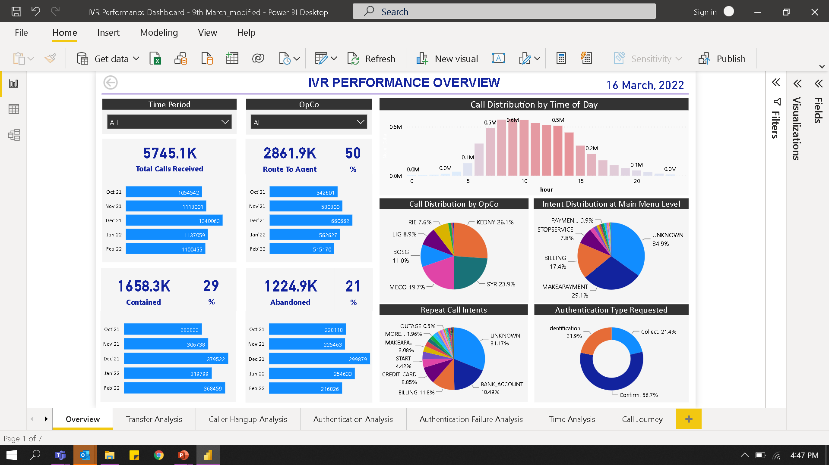
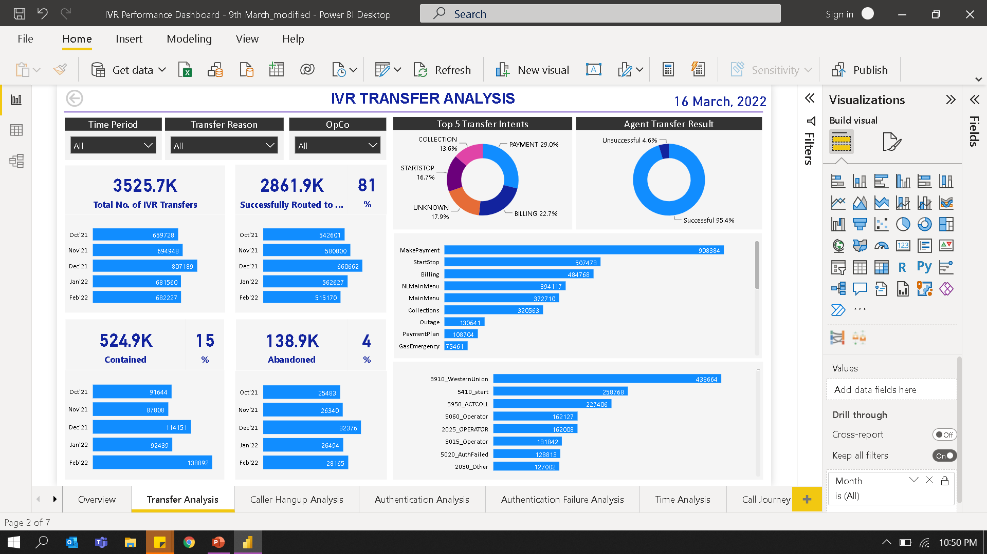
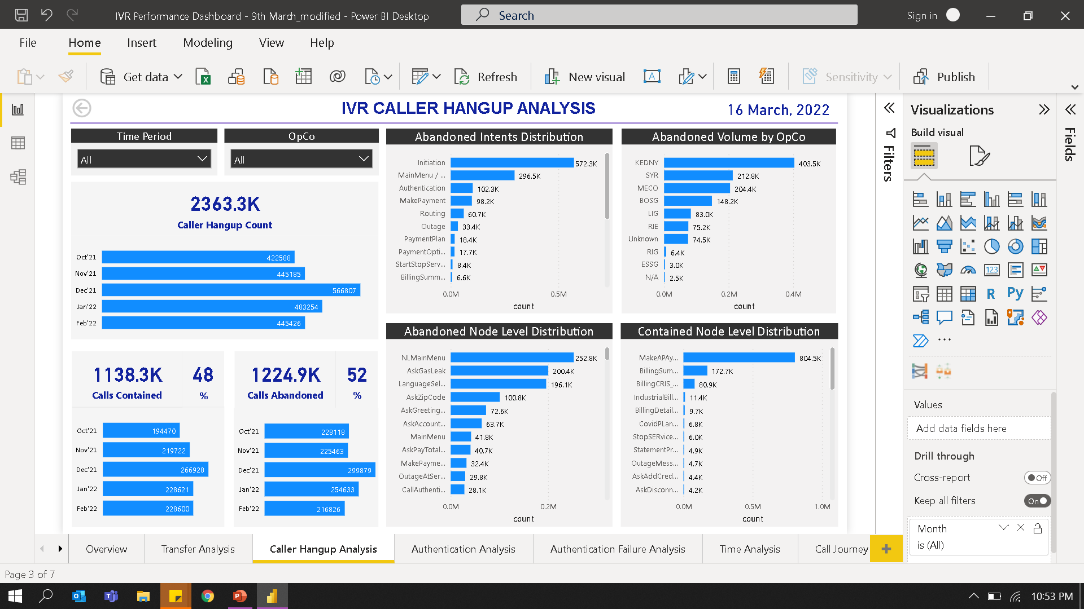
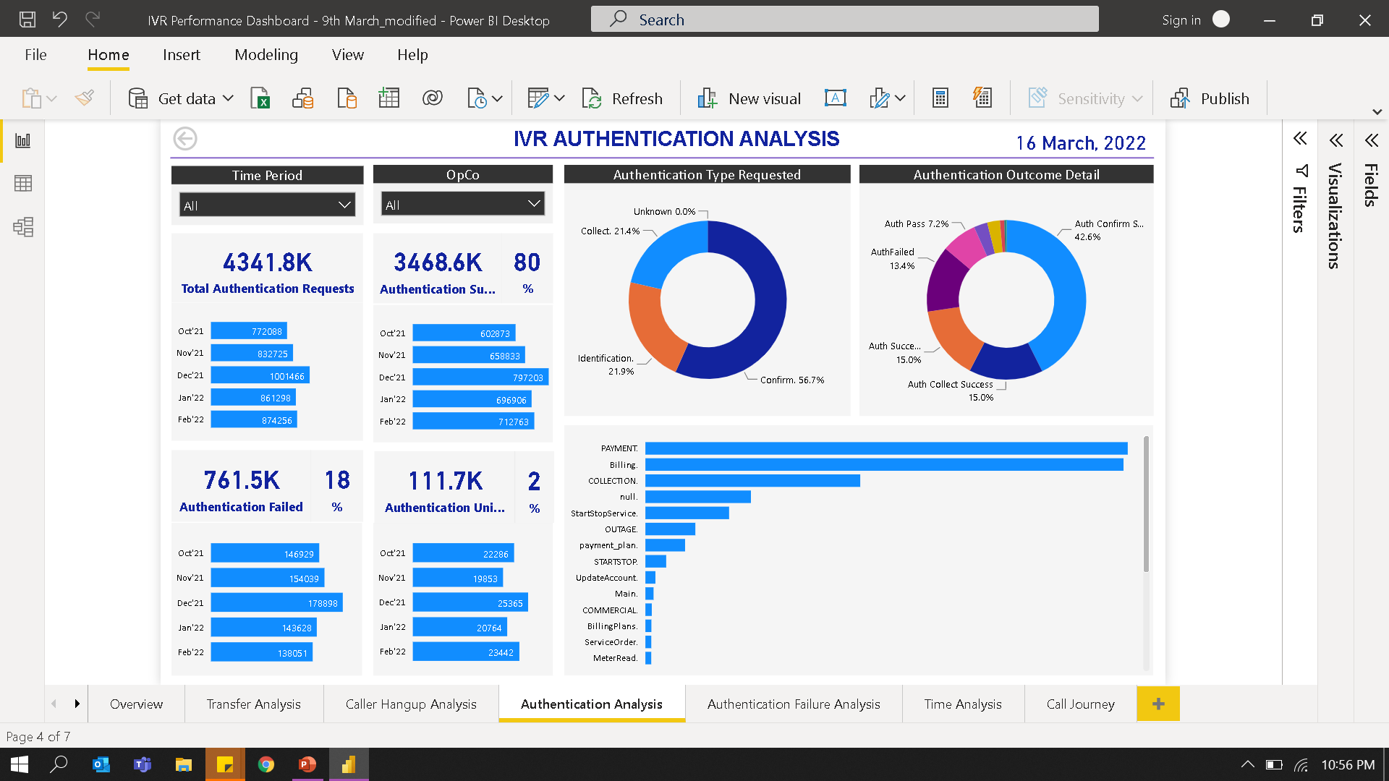
IVR Performance Dashboard
Custom designed performance dashboards have been leveraged to effectively identify tactical improvement areas, perform root cause analysis, validate hypothesis on agent fallout, and measure performance of improvements implemented.
Overall IVR performance
View to enable analysis of IVR routing to agent queues
Current Dashboard Features
Executive Reporting
IVR Containment
Primary Call Intent
Opco Level Filters
Monthly Trend Reporting
Performance Analytics
Route to Agent
Caller Hang-up
Authentication Failure
IVR Journey View
View to identify disposition of IVR sessions terminated due to caller disconnect
View to enable analysis of IVR authentication failures

Slide 7
CAR & JAR - CAR Business Definition, how it’s operationalized, why is it used
The CAR provides an integrated 360° view of customers and serves as the foundation to support customer-centric analytics. The JAR is used to identify customer transaction activity across channels.
Customer Analytics Record
Journey Analytics Record
Discover what the customer has done
Predict what the customer will do
Forms a single customer view from customer data at multiple data repositories.
Captures static and rule-based data of a customer. Derives insights from demographic, spend, billing/payment data, etc.
Analyzes the customer journeys across key customer intents and interaction channels.
Captures dynamic data in real-time. Derives insights from transactional and traversal data across multiple touchpoint.
Characteristics
Channel Activity
Example Questions Answered
What is the customer’s location?
What programs is the customer enrolled in?
What is the customer’s language/channel preference?
What is the customer’s outage history?
Example Questions Answered
What is the customer’s preferred channel?
How satisfied was the customer in those interactions?
What would be the intent for the customer’s next call?
What is the best time to interact with the customer?
Confidential Draft – For Discussion Purposes Only – Work in Progress

Slide 8
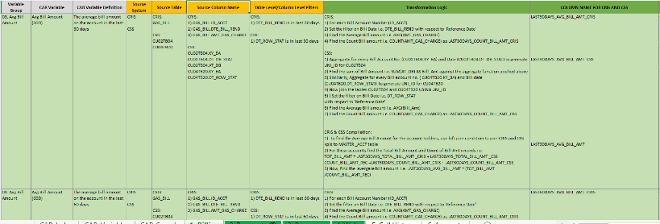
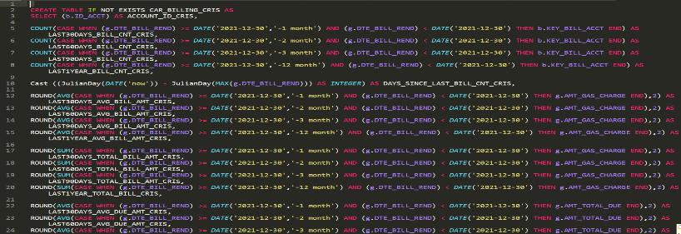
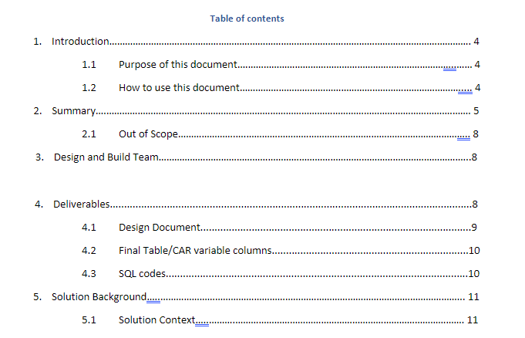
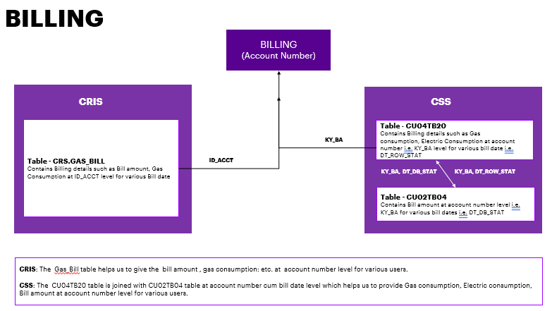
Customer Analytical Record Overview
25+
Data Extracts
8+
Data Dimensions
500+
Calculated Variables
Raw Datasets
Analytics Datasets
CAR Deliverables
Data Sources
Data Processing
Analytics Processing
Transformation
CAR Design/ Transformation
Excel
CRISS
CSS
CAR SQL Scripts
ACCOUNTS
WEB & DIGITAL
BILLING
CALL HISTORY
WEB LOGS/UWP
PAYMENT
DUNNING
ARREARS
DEMOGRAPHICS
Process Documentation
CISCO/IVR

Slide 9
CAR/JAR Use Case Matrix
 |  | Customer Initiative supported
CDP Enhancement |  | Data Operations |  |  |  |  |  |  |  |  |  |  |  |  | Data Governance
 |  |  | ZBR Operationalization
Classification | Item | ZBR | FCR DBoard | Agent DBorad | IVR DBoard | Clean Energy | AMI | CIAP Port | CCAE Port | Close Data Interruption | Enable Reporting | Customer System Migration | Outeach Lists | Enable Analytics | MDM | CDQ | Data Cataloging
Data | CSS | ● |  |  |  | ● | ● | ● | ● |  | ● | ● | ● | ● | ● | ● | ●
Data | CRS | ● |  |  |  | ● | ● | ● | ● |  | ● | ● | ● | ● | ● | ● | ●
Data | UCCE | ● | ● | ● | ● |  |  |  |  |  | ● |  | ● | ● | ● | ● | ●
Data | Calabrio | ● | ● | ● | ● |  |  |  |  |  | ● |  | ● | ● | ● | ● | ●
Data | Marketing Cloud | ● |  |  |  |  |  |  |  | ● | ● |  | ● | ● | ● | ● | ●
Data | App Insights | ● |  |  |  |  |  |  |  | ● | ● |  | ● | ● | ● | ● | ●
Data | Acxiom | ● |  |  |  |  |  | ● |  |  | ● |  | ● | ● | ● | ● | ●
Data | InfoGroup | ● |  |  |  |  |  | ● |  |  | ● |  | ● | ● | ● | ● | ●
Data | CoreLogic | ● |  |  |  |  |  | ● |  |  | ● |  | ● | ● | ● | ● | ●
Data | WebLogs | ● |  |  |  |  |  |  |  |  | ● |  |  | ● | ● | ● | ●
Data | Siebel | ● |  |  |  |  |  | ● |  |  | ● |  |  | ● | ● | ● | ●
Data | InDemand | ● |  |  |  | ● |  |  |  |  | ● |  | ● | ● | ● | ● | ●
Data | Preference Lists |  |  |  |  |  |  | ● |  |  |  |  | ● |  | ● | ● | ●
Functionality | New Data Model | ● |  |  |  | ● | ● | ● |  |  |  |  | ● | ● | ● | ● | ●
Functionality | Golden Record | ● |  |  |  | ● | ● | ● |  | ● | ● | ● | ● | ● | ● | ● | ●
Functionality | Reltio |  |  |  |  |  |  |  |  |  |  |  |  |  | ●
Functionality | Axon |  |  |  |  |  |  |  |  |  |  |  |  |  |  | ● | ●
Functionality | EDC |  |  |  |  |  |  |  |  |  |  |  |  |  |  |  | ●

